Slide 1



Slide 2






Green University of Bangladesh
Department Of Computer Science and Engineering(CSE)
Course Title: Algorithm Lab
Course Code:CSE 206 Section: 221 D8
Presented by:
Md. Mahim Hossain
ID: 221902082
Presented to
Md. Abu Rumman Refat
Lecturer, Dept. of CSE
Green University Of Bangladesh

Slide 3






Welcome To My Presentation
Cash Flow Minimizer

Slide 4



Contents
Methodology
Motivation
Findings
Objectives
Introduction
Conclusion
ER diagram
Limitations & Future Scope
Implementation
Result Analysis
Tools & Techniques

Slide 5


Introduction
The Student Admission Management System is an all-encompassing web application crafted to simplify and streamline the complex student admissions process in educational institutions.

Slide 6
Motivation
Why We're Doing This:
Simplifying with Less Manual Work:
Improving User Experience for Both Administrators and Applicants:

Slide 7
Findings
Challenges in Current Admission Processes | Manual paperwork, time consumption, errors
Potential Benefits of SAMS | Efficiency, accuracy, data-driven decisions, improved user experience
Key System Requirements | Comprehensive features, data security, user-friendly interface
Existing Systems or Research | (List relevant examples, if applicable)

Slide 8
Objectives
Design and develop a SAMS that effectively manages student admissions.
Implement features for student registration, application submission, document management, and decision-making.
Ensure data security, integrity, and confidentiality throughout the admission process.
Create a user-friendly interface for both students and administrators.

Slide 9





Primary Goals
Simplified Transactions
User-Friendly Interface
Optimized Financial Processes
Enhanced Cross-Border Collaboration

Slide 10






Methodology
Transactions & Transactions Details
Minimum Cash Flow
Wellcome
Participation
Bank Details
Output
Input from User

Slide 11


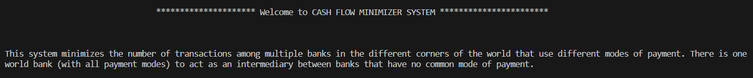

Result
Wellcome
Message

Slide 12
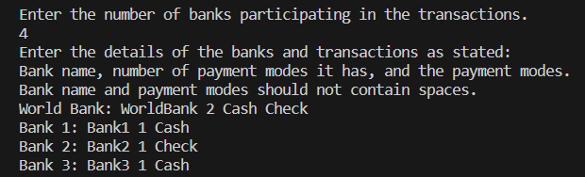
Continue...
Participation &
Bank Details

Slide 13
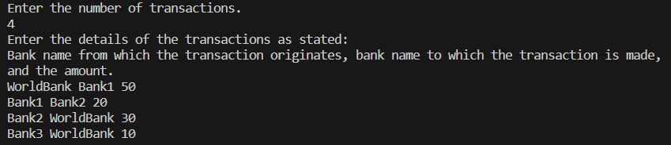
Continue...
Transactions &
Transactions Details

Slide 14
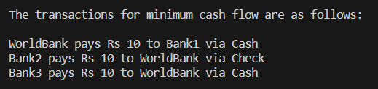
Continue...
minimum cash flow

Slide 15


Optimization for Large Datasets for User | Add Graphical User Interface | Real-Time Transaction Monitoring | Security and Authentication | User Feedback | Others
Future Work
6
5
4
3
2
1

Slide 16


Conclusion
The Cash Flow Minimizer system efficiently optimizes transactions among diverse banks, minimizing cash flow complexity. With a user-friendly interface, it streamlines global financial interactions, promoting seamless cross-border transactions. A robust solution for enhancing financial efficiency and fostering international collaboration.

Slide 17


Thanks for Watching
Md. Mahim Hossain
ID: 221902082
Contact
Any Question, Just Ask don't be shy
E-mail
faaiz.mahim@gmail.com
Phone
+880 18669-28533

